Slide 1
Hash Tables Collisions
Kurt Friedrich
Spring 2018
Good video https://www.youtube.com/watch?v=h2d9b_nEzoA

Slide 2
Chaining to resolve Collisions
Rather than a simple table, use an array of linked lists
keys that hash to the same value then stored uniquely in a linked list
LL holds object with a key prop and a value prop
0
null
1
LL
K=3 V=“VP”
2
LL
K=7 V=“SecA ”
K=9 V=“SecF”
3
null
4
LL
K=12 V=“SecC”
5
LL
K=13 V=“SecB”
6
LL
K=1 V=“SecK”
K=19 V=“Attn”
K=6 V=“Pres”
7
LL
K=14 V=“SecG”
8
null
…

Slide 3
Hash table of linked lists
To insert a key K and value
Create a “item” object and set its 2 properties with K and value
Compute h(K) to determine which list to traverse
If that array element contains a null, instantiate a new LL there, and add the new “item” object to the new linked list.
If that array element already has a LL, just add the new “item” at the beginning of this list.
This will be O(1)
To find a value (or delete), compute h(K) to pick the list, and then walk the list until you find an object with a prop key that matches the original key, not the hash(key), and then return the value string (or delete the node).
This will be O(1) + O(n) where n is the length of the LL. Assuming a good distribution algorithm, the LLs will be quite short, so we are really still close to O(1)

Slide 4
Maybe these will help

Slide 5
Array of data type LinkedList
null
null
null
null
null
null

Slide 6

Array of data type LinkedList
0
1
2
3
4
5
null
User wants to insert an entry,
Key = 16, Value = “Fred”
16 “hashes” to a 2
null
Create a new LinkedList and put it in the array
at the index returned from hashing the user’s key
null
null
null

Slide 7

Array of data type LinkedList
null
Now create a node, save the key and value in it,
and insert it into the LL
null
16
Fred
null
null
null

Slide 8

Array of data type LinkedList
null
null
If more nodes have keys that hash to the
same location, add them to the same LL
null
null

Slide 9
Array of data type LinkedList
null
null
When user wants to remove by key = 16
hash the 16 to find out which LL to look in.
In this case, 16 hashed 2
Now search each “folder” (node) in the LL
for the folder that has the user key of 16,
then return that folder’s value “Fred”
null
null

Slide 10
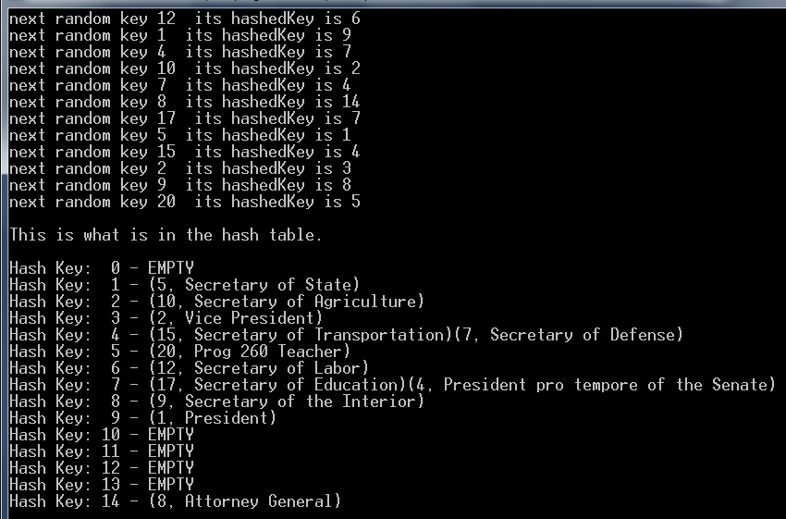

Slide 11
Key, Value, NextNode
Ele 0: Null
Ele 1: TopOfLL => 5, Secretary of State, null
Ele 2: TopOfLL => 10, Secretary of Agriculture, null
Ele 3: TopOfLL => 2, Vice President, null
Ele 4: TopOfLL => 15, Secretary of Transportation, => 7, Secretary of Defense, null
Ele 5: TopOfLL => 20, Prog 260 Teacher, null
Ele 6: TopOfLL => 12, Secretary of Labor, null
Ele 7: TopOfLL => 17, Secretary of Education, => 4, President pro tempore of Senate, null
Ele 8: TopOfLL => 9, Secretary of the Interior, null
Ele 9: TopOfLL => 1, President, null
Ele 10: Null
Ele 11: Null
Ele 12: Null
Ele 13: Null
Ele 14: TopOfLL => 8, Attorney General, null

